Slide 1

ODKG: HANDS-ON
Group 8
Wenqi Jiang
Carlo Magnani
Julio Nevado
Nacho Mendez-Bonito

Slide 2
SUMMARY
The Dataset
The Ontology
Data Linking and RDF generation
Publishing RDF
The application
Lessons learned

Slide 3

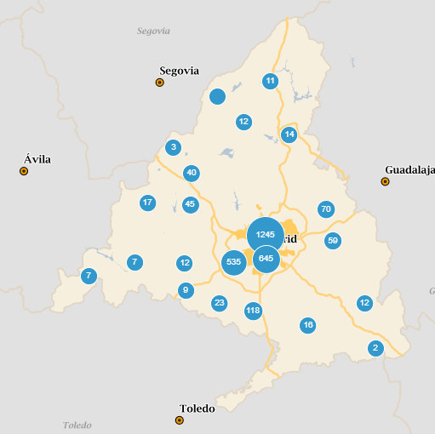
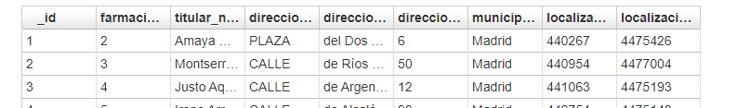
THE DATASET
Id
Pharmacy Number
Owner
Address Type
Address Name
Address Number
Municipality
X coordinates
Y Coordinates
Dataset pertaining addresses and owners for the pharmacies in the "Comunidad de Madrid"

Slide 4
THE DATASET
Data cleaning
Problematic characters removal: [“”,’ª]
Missing values completion
Resources identifiers by combining some columns
Some street numbers are regular numbers and other km -> split into two columns
Reconciliation of some values (CTRA CRTRA -> CTRA)
Data Linking:
Streets: very little coincidences
Municipality: full reconciliation

Slide 5
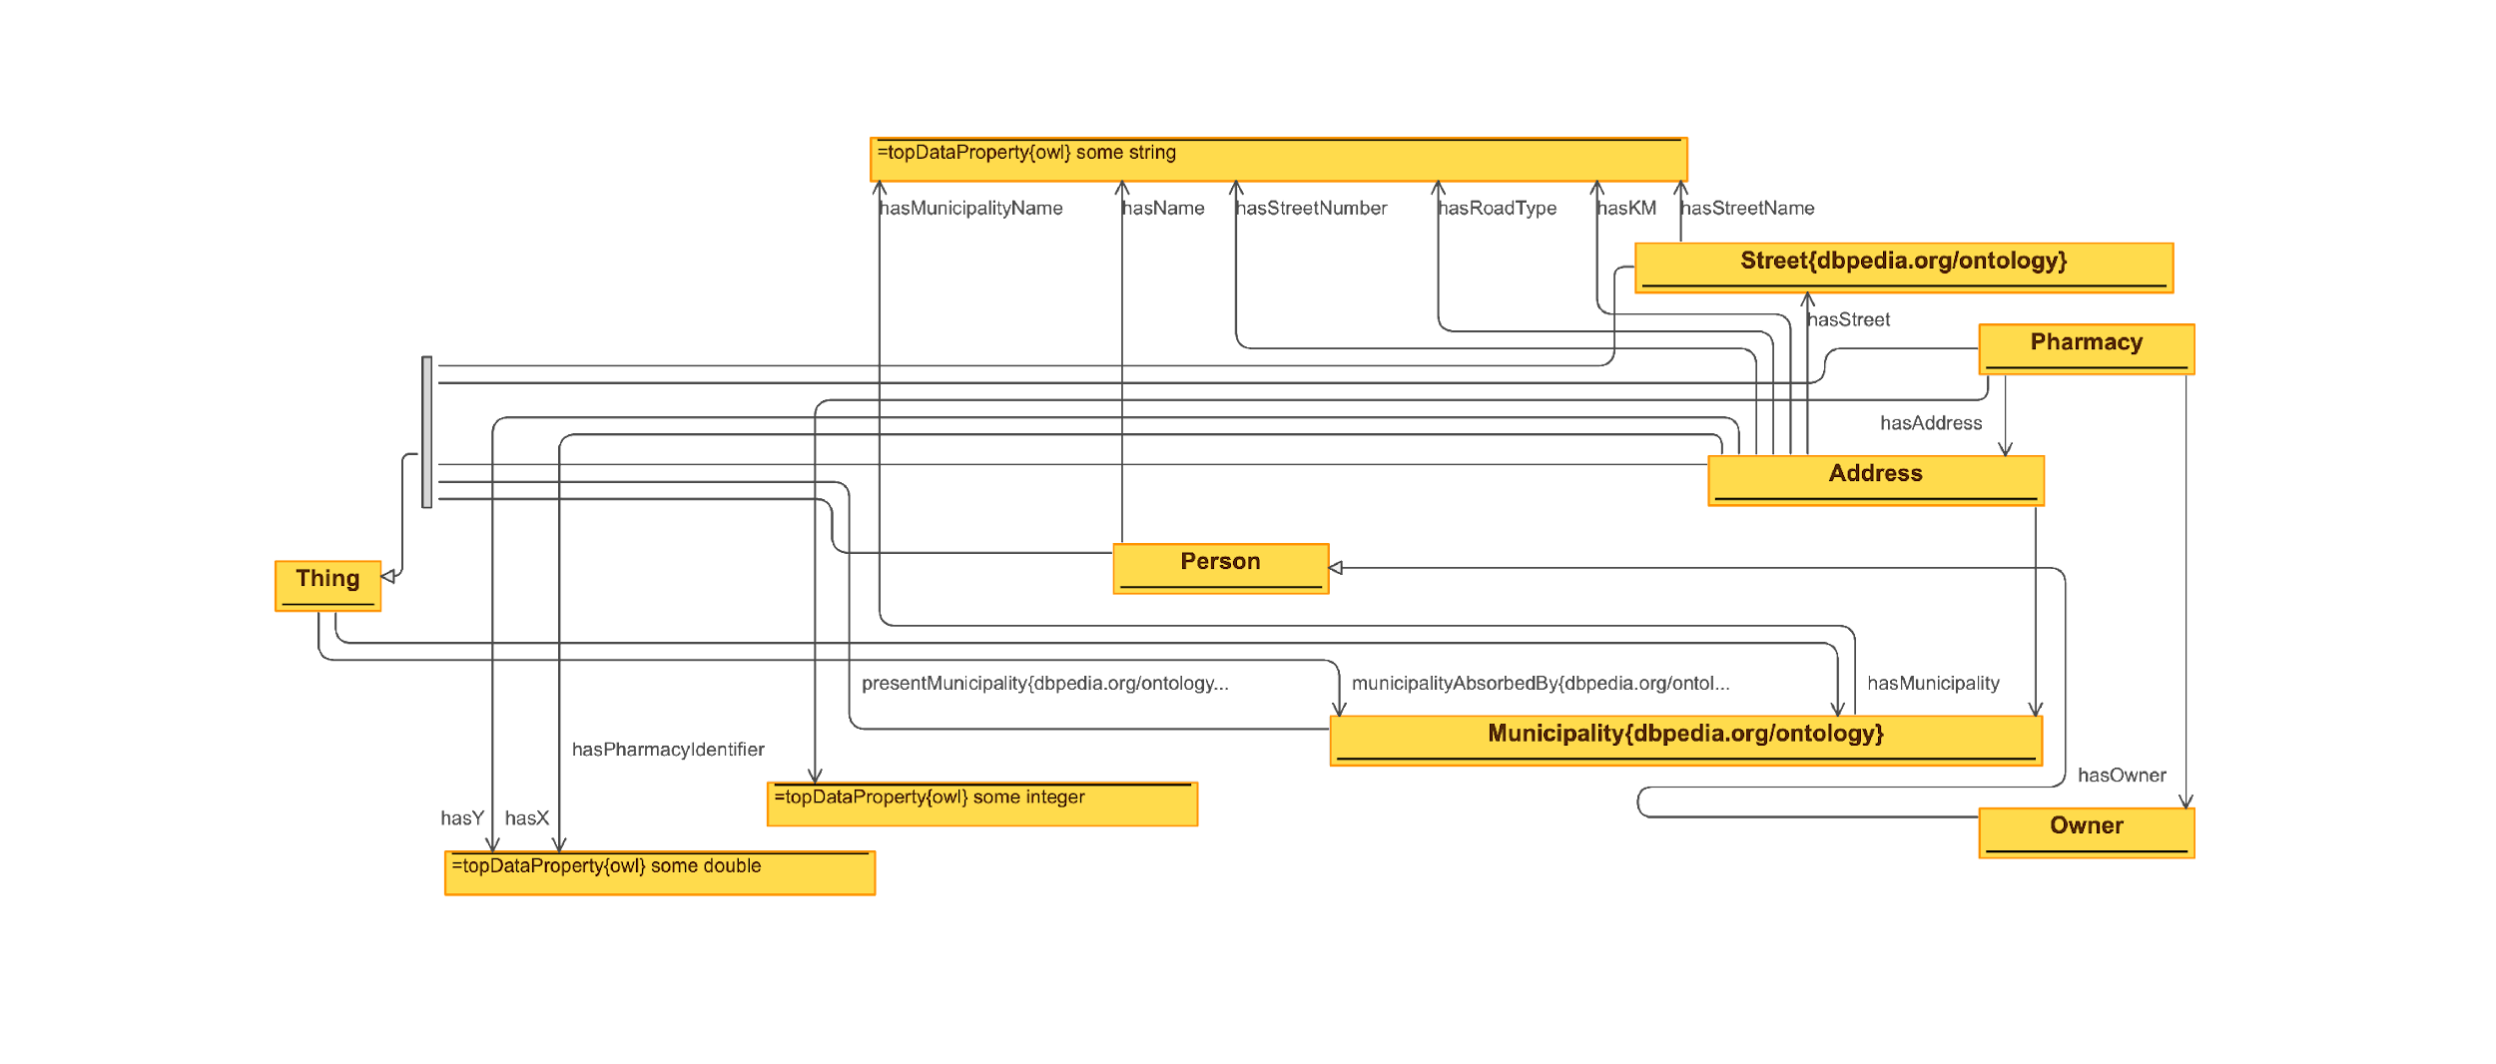
THE ONTOLOGY
Reused ontologies:
dbpedia street
dbpedia municipality
Tools used: Protégé

Slide 6





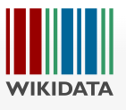
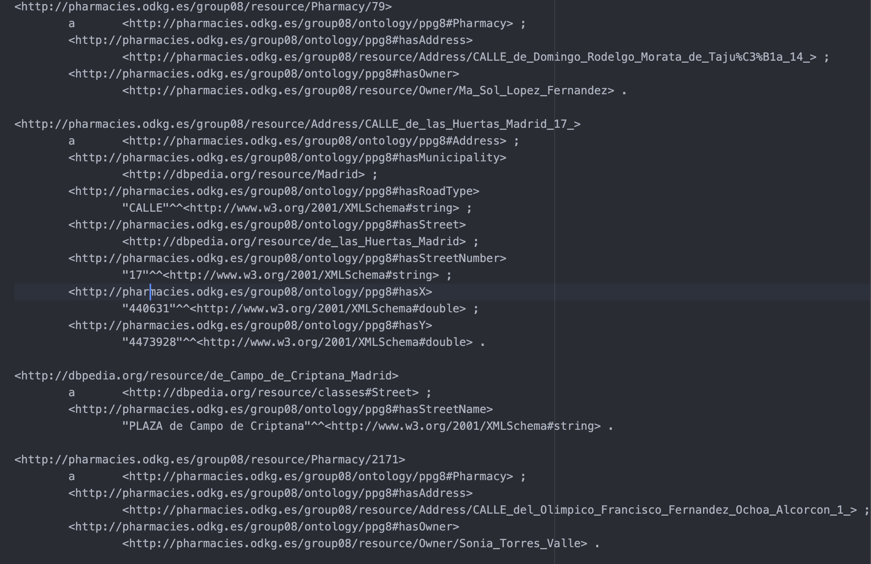
LINKING DATA & RDF GENERATION
The process we followed
Municipality
Street (Madrid)

Slide 7
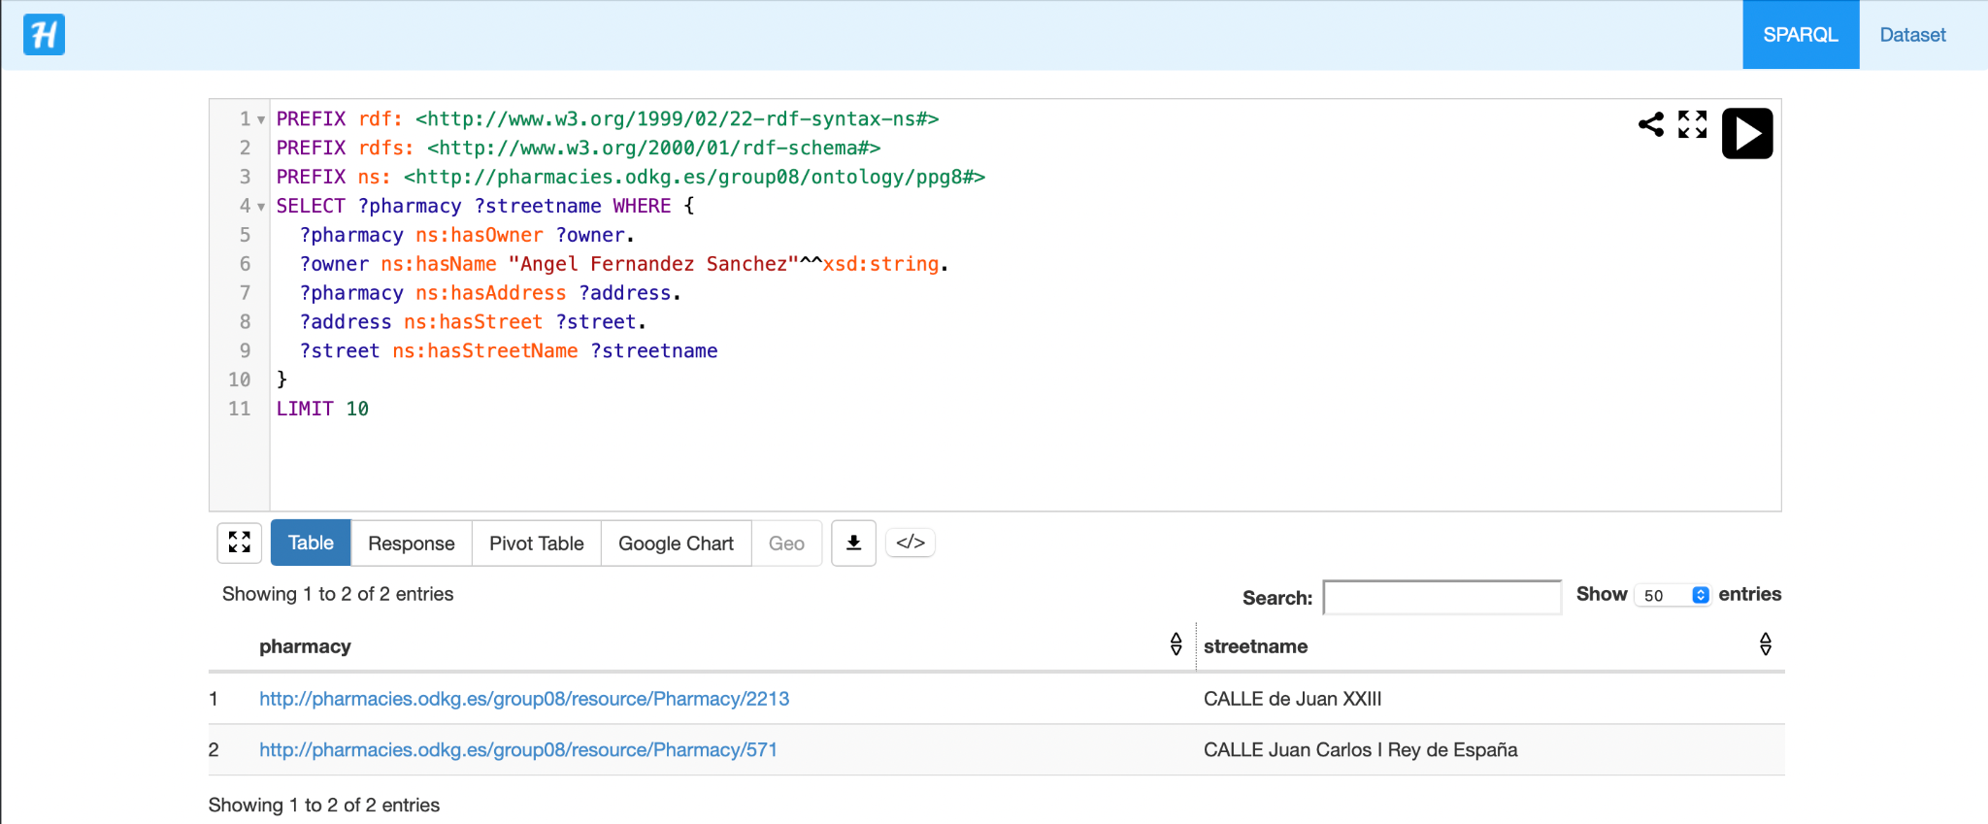
PUBLISHING RDF

Slide 8
APPLICATION
Medical APP.
Retrieving of:
Nearest Pharmacy
Nearest Hospital in the same municipality of the Pharmacy
Based on
Street name provided by the user
Coordinates provided by the user if street name not available in our dataset
Using
SPARQL queries over our dataset
SPARQL queries over Wikidata using our linked data

Slide 9
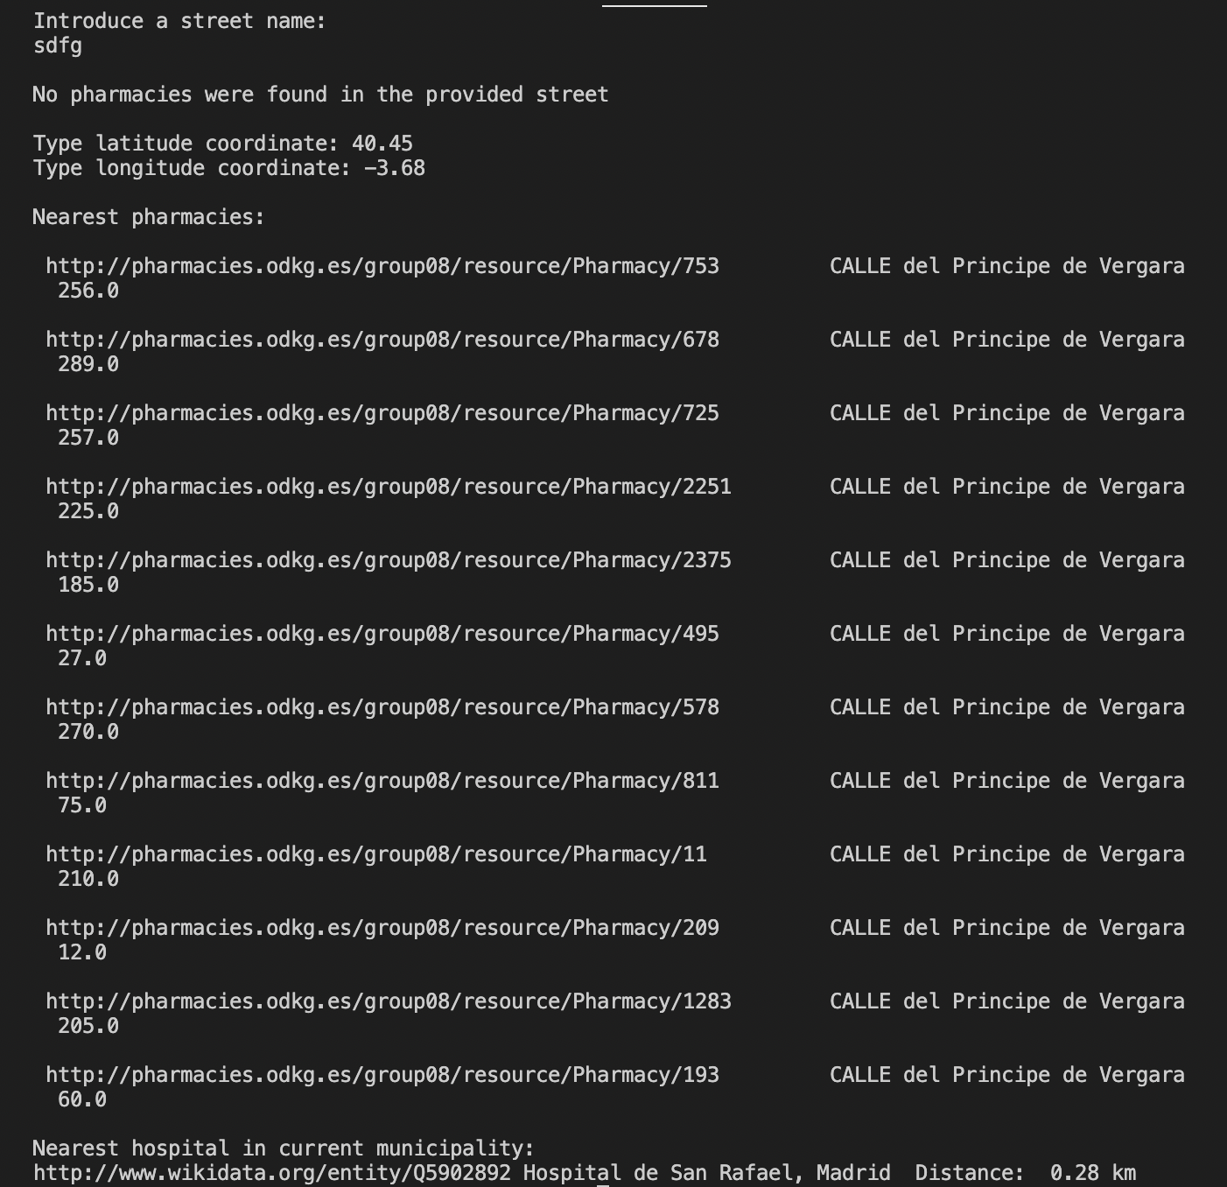
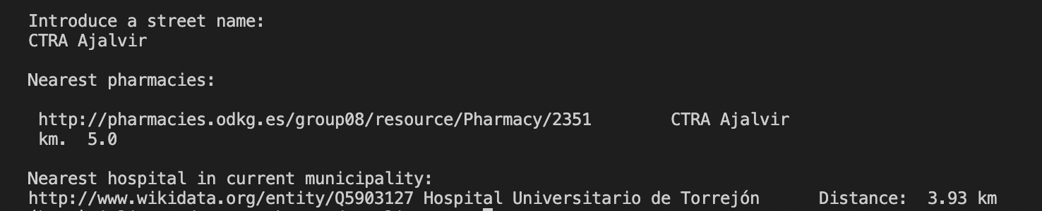
APPLICATION

Slide 10
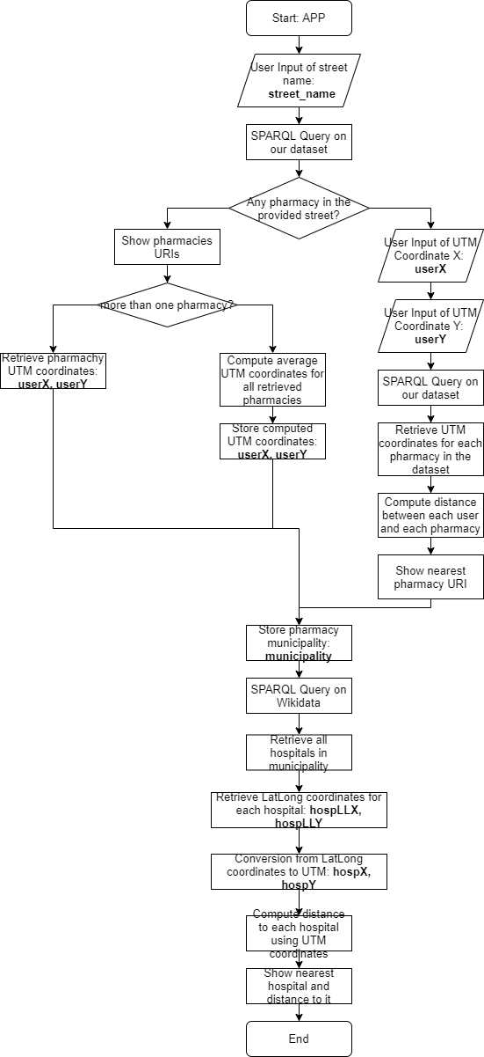

Slide 11
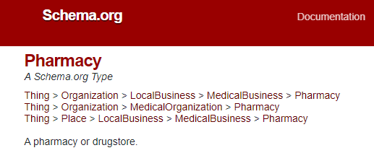
LESSONS LEARNED
Reusing more ontologies
Linking more data (e.g. other businesses)
Streamline the process
Get paid!

